Slide 1
Roles of system dynamics
Name Samra Jannat
Roll no. Bscs f19M66
Subject software project Management
Author’s name Alexander Rodrigues

Slide 2
Introduction
SYSTEM DYNAMICS is a computer-based mathematical modeling approach for strategy development and better decision making in complex systems. This approach uses computer-aided simulation methodology based on feedback systems theory which complements the other Systems Thinking approaches.
System Dynamics models offer deeper strategic understanding and insights into the efficacy of various managerial practices
This paper offers a strategy for integrating traditional models with System Dynamics lessons into a single, integrated project management methodology.
A fresh strategy built on System Dynamics models is currently evolving. This method, which assumes a comprehensive perspective of the organization, focuses on the behaviorl trends of projects and how they relate to managerial tactics. Morris and Hough2 have also noted the need for the creation of models that can evaluate strategic issues, noting that "(conventional) project management has not addressed itself the variables which often genuinely cause projects to fail... We must admit that there is a genuine need for such a paradigm of strategic management. It is difficult or even impossible to rely simply on conventional PERT/CPM system approaches, according to Davidson and Houtl . The answers demand a new paradigm for the control of large projects that is based on an open and dynamic system architecture

Slide 3
Background
Increasing complexity Weakness of traditional approach Project failure Lack of systematic management Comparison of view Identifying a cycle Operational and strategic issues

Slide 4
Methods
Technique/Tools | Purpose
Work Breakdown Structure - WBS | Basic definition of the project work. Precedes the project schedule and cost estimations.
Responsibility matrixes | Integration of the project organization with the WBS -- assignment of responsibilities.
Bar charts or Gantt Charts | Simple representation of the project schedule.
Project Network Techniques: PERT, CPM, PDM, GERT, and others. | Network techniques for work scheduling. Provide the analysis of the scheduling impacts that activities have on each other and the determination of critical activities and float times.
Cost Schedules | Identification of the capital requirements for resources.
Project Control: variance analysis, PERT/cost, Earned Value, and others. | Assessment of project performance with the generation of performance indices

Slide 5
Evaluation
Nature of the Managerial Needs | Traditional Approach | System Dynamics Approach
Specification of the work | Yes | No
Assignment of responsibilities to the work within the organization | Yes | No
Work Scheduling | Yes | No or High level
Resources Management / Scheduling | Yes | Yes – High level
Cost Estimation / Budgeting | Yes | Yes
Project Control / Monitoring | Yes | Yes
Evaluate the impacts of decisions | Yes | Yes
Evaluate the impacts of uncertain events | Yes | Yes
Post Mortem diagnosis | No | Yes

Slide 6
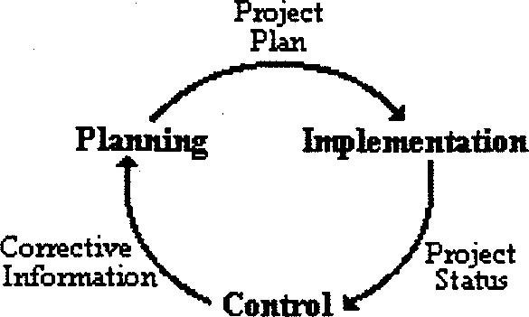
Analysis and Results
Analysis Both methods view project management as an active process of planning, carrying out, and monitoring.
Result: Models of system dynamics assume a high level view of the entire project management process with a focus on managerial decisions and human variables. The models employed in the traditional method are more specialized, place more emphasis on the project work organization, and assume a close examination of each step in the project management process.

Slide 7
Conclusion
Weakness of traditional approach System dynamic analysis Undue focus Improvement needed Core role

Slide 8
References
Abdel-Hamid, Tarek K. And Madnick, Stuart E., “On the Portability of Quantitative Software Estimation Models.” Information & Management, 13 (1987), l-10. Abdel-Hamid, Tarek K.,”Understanding the 90% Syndrome in Software Project Management: A simulation Case Study.” The Journal of systems and Software, 8 (1988), 319-330. Abdel-Hamid, Tarek K., “The Economics of Software Quality Assurance: A Simulation-Based case Study.” MIS Quarterly, September Weil, Henry Birdseye and Dalton, William J., “Risk Management in Complex Projects.” Pugh-Roberts Associates – PA Consulting Group. Williams, T.; Eden, C. And Tait, A., “The Vicious Circles of Parallelism.” University of Strathclyde, Strathclyde Business School, Management Science, Working Paper: Theory Method and Practice Series, January, 1994 Wolstenholme, Eric F. (1990), System Enquiry – A System Dynamics Approach, Chichester: John Wiley & Sons.

